Slide 1
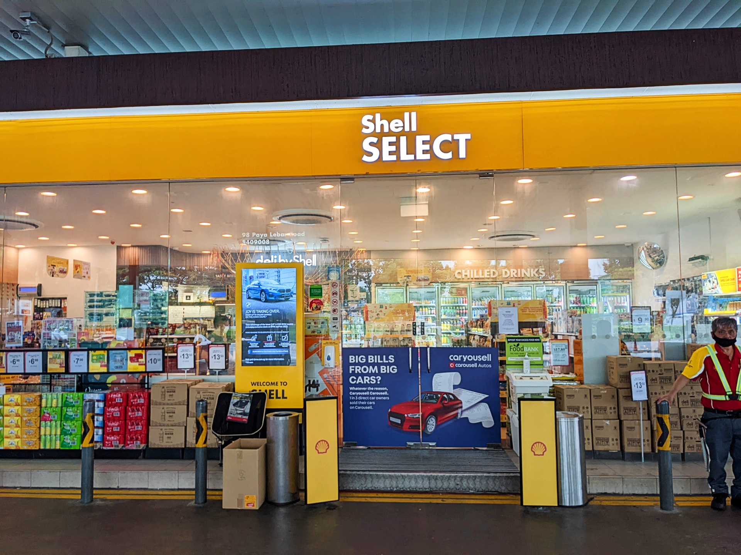
OPTIMAL Stocking Strategy
Best Cart Mini Marts
Capstone Project team members:
Sathya, James, Zuzana, Muzammil, Maryan, Sujana and Adele

Slide 2
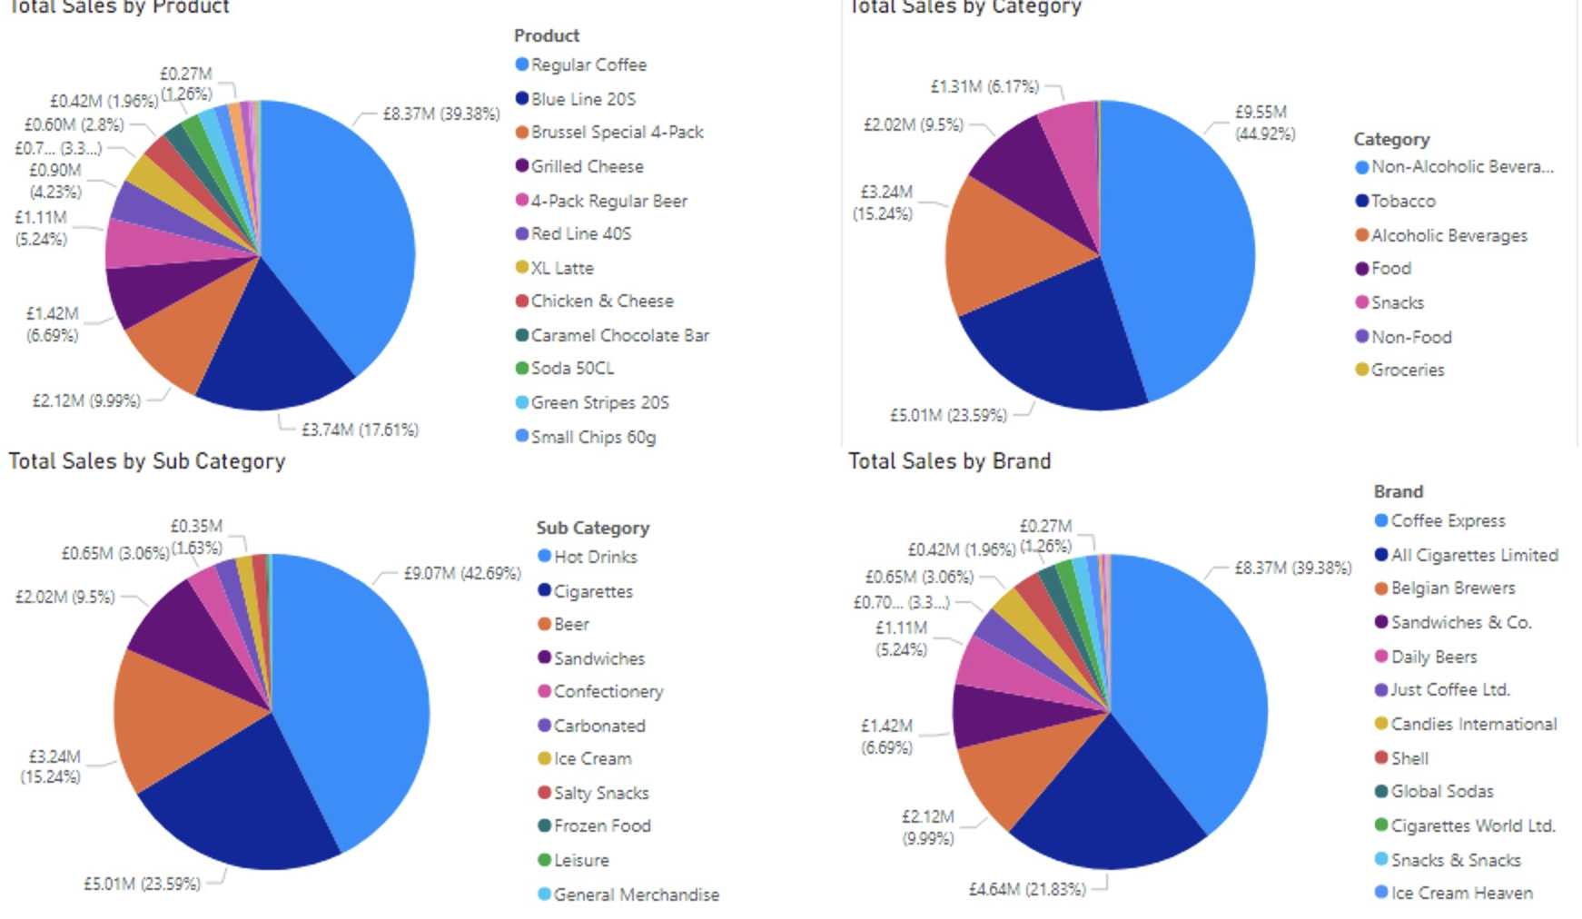
Overall sales

Slide 3
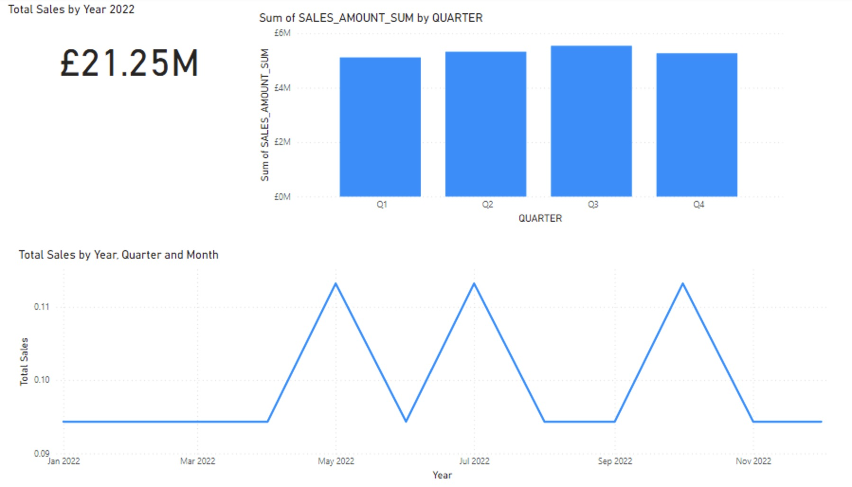
Trends for 2022

Slide 4
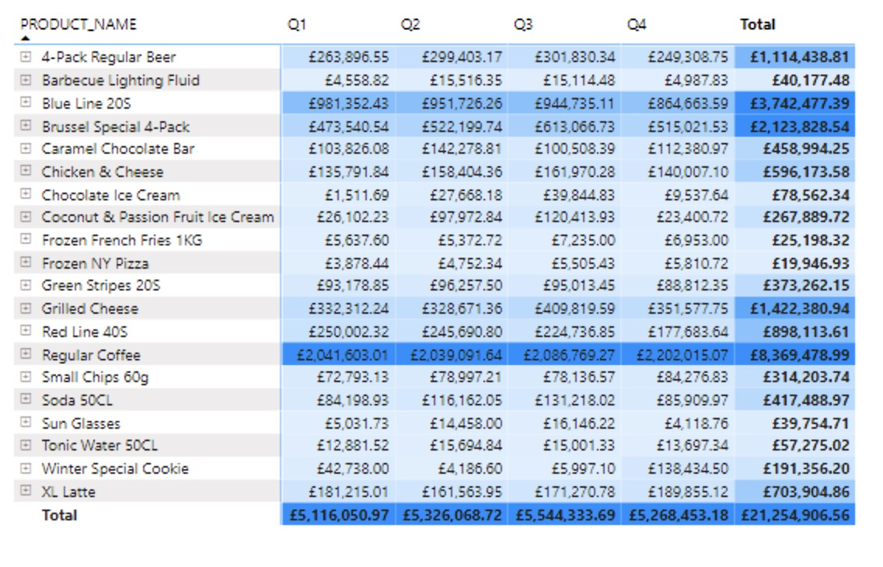
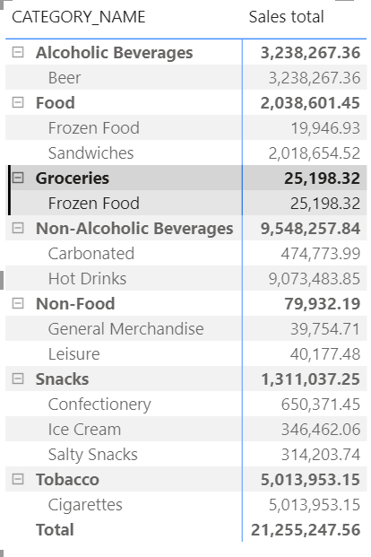
Seasonality

Slide 5
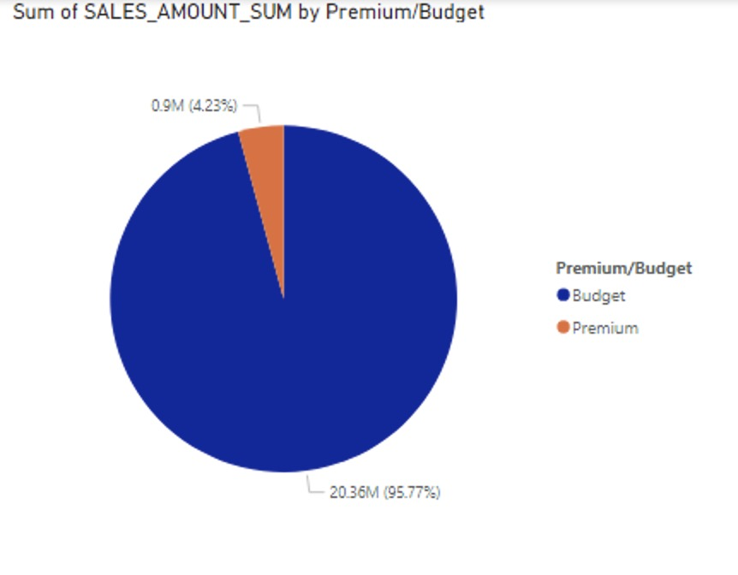
Premium and Budget Products

Slide 6
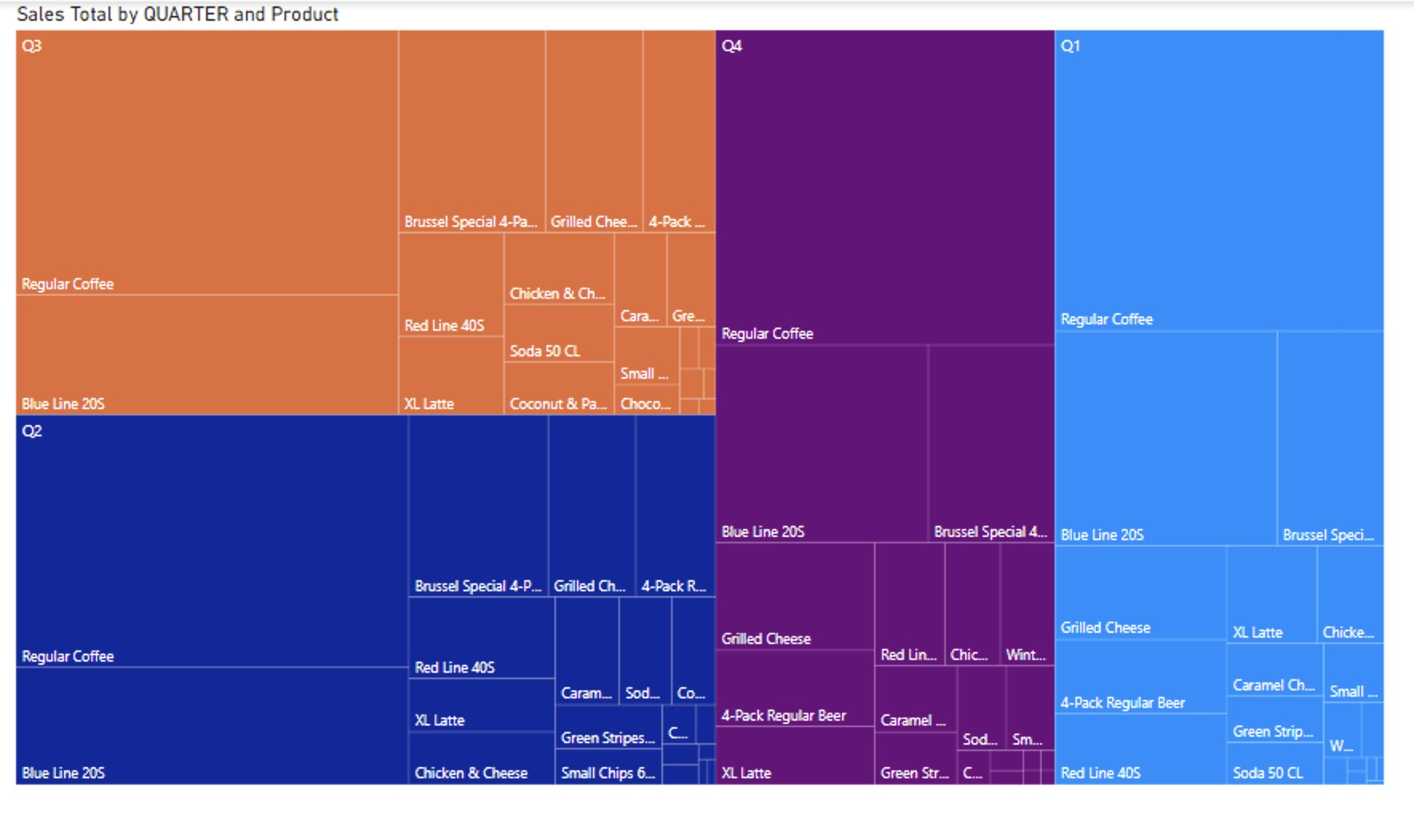
Largest Sales Per Quarter

Slide 7
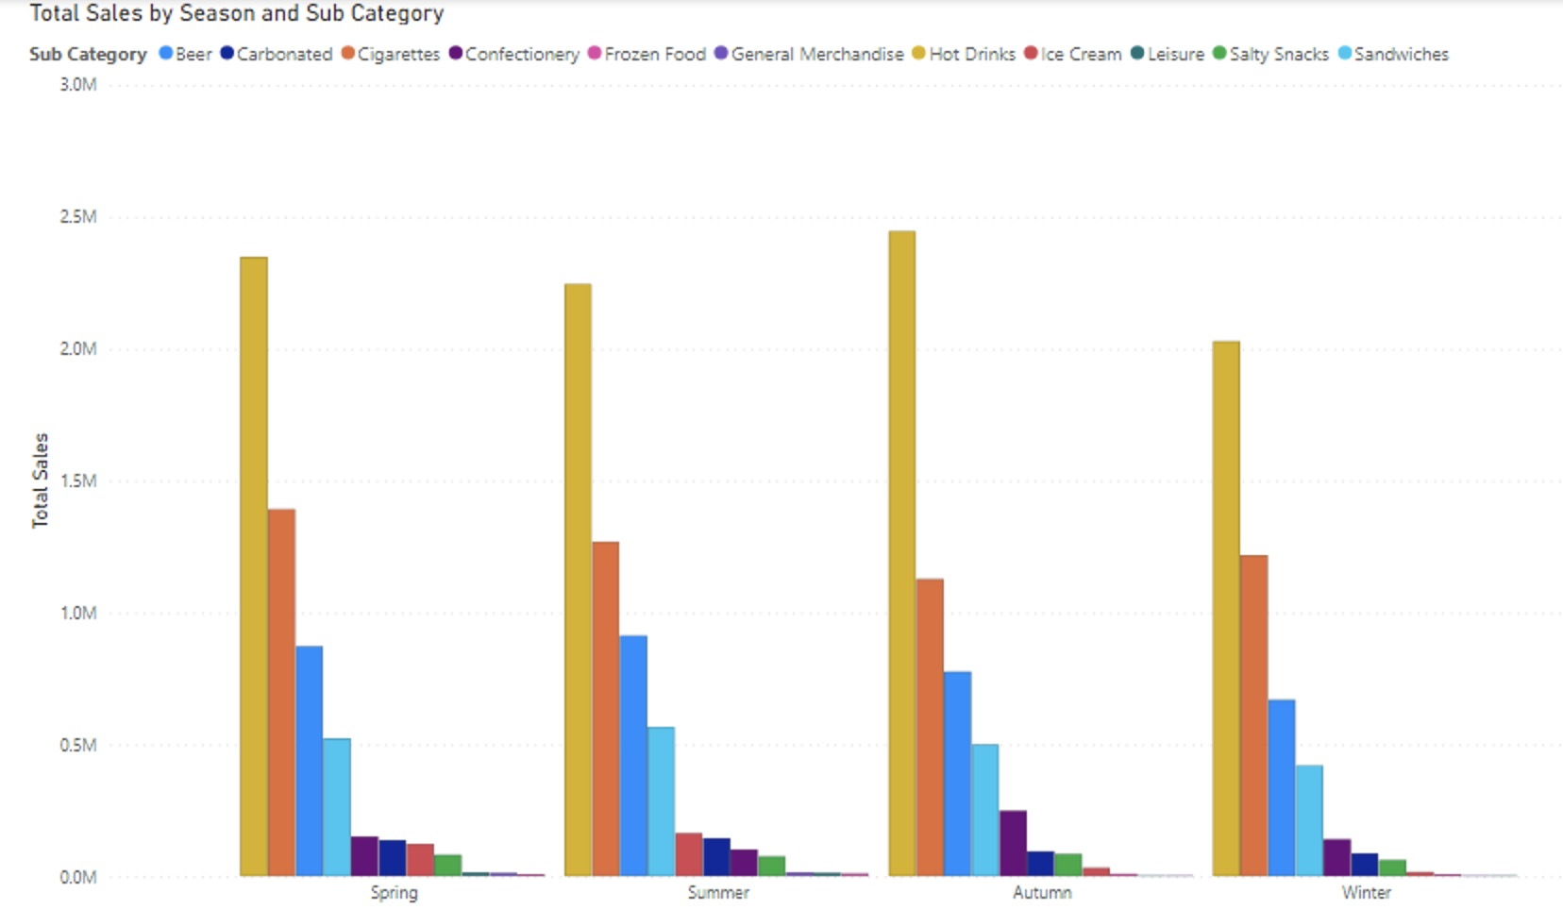
Product Peak by Seasons

Slide 8
Summary of Findings/Strategy
Consistent sale of Sandwiches, Drinks & Crisp
Meal Deal
Special promotions for winter cookies in Q4 with hot beverage
Boost in summer related goods in Q3
promotion in sunglasses, frozen foods & barbecue fluid
exploring adding diverse product range of summer related goods
Stock Reduction Data Inconclusive
Potential reduction stocking of budget product and increase stock of premium product
More primary research required / field observation / collaboration with key stakeholders

Slide 9
SWOT Analysis
Just In Time Strategy
Stock Monitoring To Reduce Scope 1 Emission
Optimize Inventory Management
Shell GO +
Climate Uncertainty
Lack Of Data Quality And Clarity
Product differentiation
Waste Audits
R&D
Seasonal Demand
Climate change
Supply chains and Supplier risk
Emission from storage of frozen goods

Slide 10


